Slide 1
Power window control system using Tiva C running FreeRTOS
Team 1

Slide 2
01
Project description
02
System Flowchart or state diagram
03
Circuits topologies
04
Handling of all the test and corner cases
05
Role of each team member
CONTENTS

Slide 3
01
Project description

Slide 4
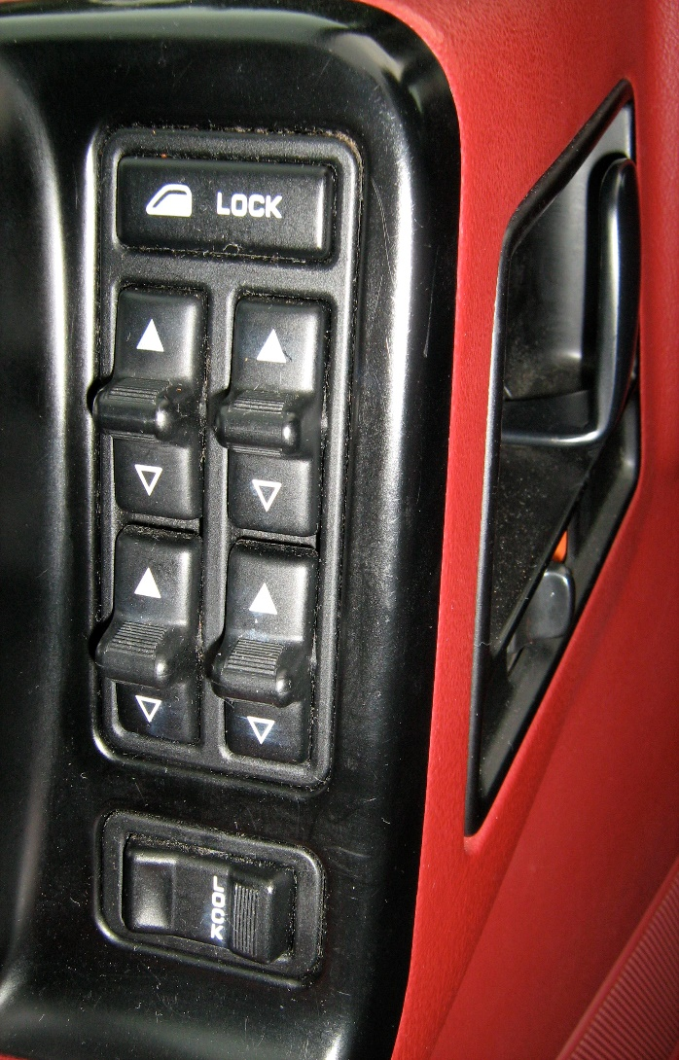
1.Project description
The project utilizes FreeRTOS library in a C code.
The code includes Semaphore , Queue and Mutex
The main function of the project is to control the movement of a motor up and down using various switches.
The project includes several global variables, including Lock, switch flag , Auto manaual, Global state .
The project has a Task Switch function to control switch state and a Task Limit function to check for limit switches.
The project has a Task Driver function that controls the driver movement based on the input from the switches.

Slide 5
1.1Project description
The project also has a Task Passenger function to control passenger movement using a push button.
The code includes functions for GPIO initialization and handling interrupts for both PORTA and PORTE.
The code includes functions for GPIO initialization and handling Motor for PORTB.
The project uses a semaphore to ensure mutual exclusion and prevent race conditions.
The project uses a Mutex to ensure choosing of the Global Variables not the tasks
The project uses a queue to store driver and passenger input values taken from the semaphore

Slide 6
Idle 4. Lock
Driver 5. Limit
Passenger 6.Obstacle
02
System Flowchart or state diagram

Slide 7
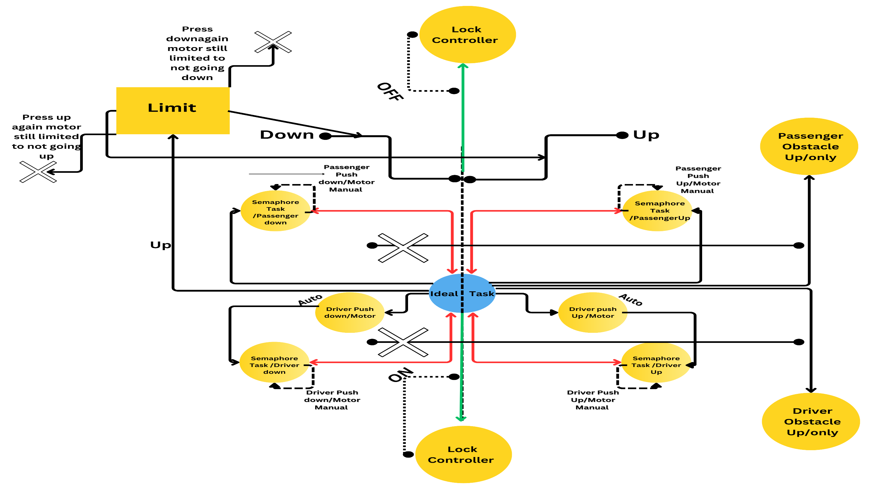

Slide 8
03
Circuits topologies

Slide 9
3.Circuits topologies
Port A : Used for all interrupts
The Driver UP and Driver Down are connected to GPIO Port A pins 2 and 3, respectively
The Passenger UP and Passenger Down are connected to GPIO Port A pin 6 and 7 respectively
Port B : used for motor configuration
#define Motor1PIN1 P0
#define Motor1PIN2 P1
Port E : used for obstacle PE2 and Limit PE3

Slide 10
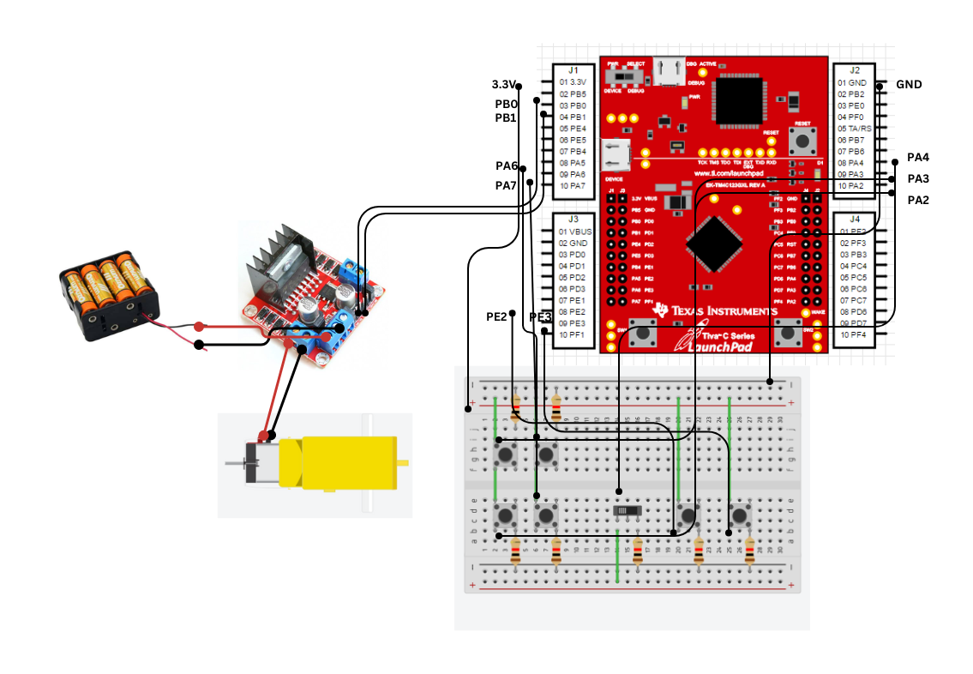
Tiva C
12V BATTERY
H-Bridge
Driver Up
Passenger Up
Lock
12V DC Motor
Passenger down
Limit
Obstacle
Driver down
Breadboard

Slide 11
Mutex
Semaphore
Queue
04
Handling of all the test and corner cases

Slide 12
4. Handling of all the test and corner cases
Mutexes are used to ensure that only one task at a time can access the shared
resource, this is achieved by allowing tasks to take and give back ownership of a mutex
but in our case the mutex is not provided to ensure which task at this time is accessed
Mutex is used to ensure which global variable has the time to be executed now
Global Variables:
- `SwitchFlag`: flag to detect the state of the switch
- `lock`: flag to detect the state of the lock
- `LimitSwitch`: flag to detect if the motor has reached its limit switch
- `AutoManual`: flag to detect if the system is in auto or manual mode
- `GlobalState`: flag to detect the current state of the system
- `UP`: flag to represent the "UP" direction of the motor
- `DOWN`: flag to represent the "DOWN" direction of the motor
- `counterSwitchManual`: counter to detect if the manual mode should be activated

Slide 13
4.1 Handling of all the test and corner cases
Semaphores
semaphores here trying to take and take from tasks so if checking the priority it getting block till it delivers to the Idle hook so Tiva starts to toggle red
several semaphores are used to synchronize access to shared resources between different tasksThe SemaphoreHandle_t type is defined in the "semphr.h" header file and represents a
semaphore in FreeRTOS. Semaphores are similar to mutexes in that they can be used to
protect shared resources, but they can also be used to synchronize tasks and interrupt handlers
It is possible that one or more of the semaphores used in this code are implemented using a mutex internally. For example, the SemaphoreDriver semaphore might be implemented using a mutex if it is used to protect access to a shared resource that can only be accessed by one task at a time

Slide 14
4.2 Handling of all the test and corner cases
- `SemaphoreDriver` is a semaphore handle for the driver task.
- `SemaphoreSwitch` is a semaphore handle for the switch task.
- `SemaphorePassenger` is a semaphore handle for the passenger task.
- `SemaphoreLimit` is a semaphore handle for the limit task.

Slide 15
4.3 Handling of all the test and corner cases
Queue :
In this Project, there are two queues that are used to communicate between tasks:
xQueueDriver and xQueuePassenger.
The xQueueDriver is used by the TaskDriver() task to receive commands (UP or DOWN) from the interrupt service routine (ISR) of the Driver switch. Whenever the driver switch is pressed, the ISR sends a message to the queue containing the command that was received. The TaskDriver() task waits for messages on this queue, and when it receives a message, it processes the command by moving the motor in the appropriate direction.
The xQueuePassenger is used by the TaskPassenger() task to receive commands (UP or DOWN) from the interrupt service routine (ISR) of the Passenger switch. Whenever the passenger switch is pressed, the ISR sends a message to the queue containing the command that was received. The TaskPassenger() task waits for messages on this queue, and when it receives a message, it processes the command by turning on/off the passenger LED in the appropriate direction.

Slide 16
4.4 Handling of all the test and corner cases
Queue :
Both queues are created using the xQueueCreate() function, which takes two arguments: the
maximum number of items the queue can hold, and the size of each item in bytes. In this case, both queues are created with a maximum capacity of 10 items and a size of 1 byte (since each item is just a single character representing the command).
The xQueueSendToBackFromISR() function is used to send a message to a queue from an ISR,
while xQueueReceive() is used to receive messages from a queue in a task. Whenever a
message is sent or received, the appropriate semaphore is given to notify the waiting task
that a message is available.
Queues are a powerful tool for inter-task communication in FreeRTOS, allowing tasks to exchange data without having to directly access each other's variables or functions

Slide 17
Design and implementation
Hardware
Code flow
Code Implementation
Integration
05
Contribution

Slide 18
5.Contribution
Names | Design and implementation | Hardware | Code flow | Code Implementation | Integration
Mohamed Ibrahim 18P2457 | 33% | 40% | 33% | 35% | 25%
Yousef Hijazi 18P2566 | 33% | 40% | 34% | 35% | 25%
Ahmed Hazem 15P8109 | 34% | 20% | 33% | 30% | 50%

Slide 19
THANK YOU

